Slide 1
FIBRES Trend radar templates

Slide 2
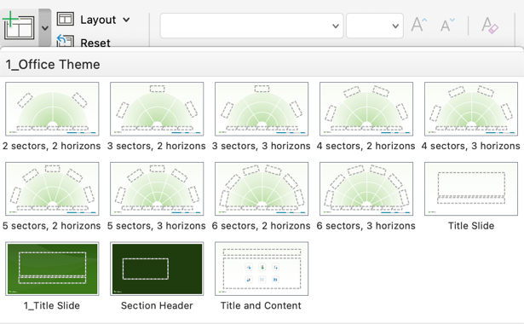

Step 1: Select correct layout
There are 12 different trend radar layouts in this file with different number of horizons and sectors.
Pick a radar layout that suits your purpose the best from the “New Slide” menu.
  Example: For a PESTEL trend radar, select one of the 6-sector layouts.
  Read more → Trend radar 101

Slide 3
Step 2: Rename sectors and horizons
Rename the radar sectors and horizons to your liking.
  Example: Use a domain-based dimension for the sectors (PESTEL) and an action-based dimension for the horizons (Act-Plan-Observe).
  Read more → Choosing the best horizons for your radar
  Read more → Which sectors should you select for your radar

Slide 4
Step 3: Add your trends
Copy and paste trend bubbles to your radar from below.
  Pro tip: When resizing the trend, keep the Shift key pressed down to keep the proportions the same.
Copy and paste to your trend radar
Copy and paste to your trend radar
Copy and paste to your trend radar
Copy and paste to your trend radar

Slide 5


Step 4: Export and share
Now it’s your time to shine!
Share your trend radar with your colleagues and stakeholders.
  Pro tip: PDF exports work wonderfully if you want to share a snapshot of your radar.
Trend radar templates © 2024 by FIBRES are licensed under CC BY 4.0

Slide 6
Example: A 2-sector, 2-horizon trend radar comparing different trend radar solutions
Purpose-built software
Workarounds
Miro
Self-coded solutions
Powerpoint
FIBRES
Low
High
Level of automation
High
Low

Slide 7
Get to the next level
Updating trend radars in PowerPoint can get tedious. When you want a better way to manage and share your live radars, try the FIBRES trend radar builder.
Book a demo or start a free trial of FIBRES
http://www.fibresonline.com/get-started

Slide 8
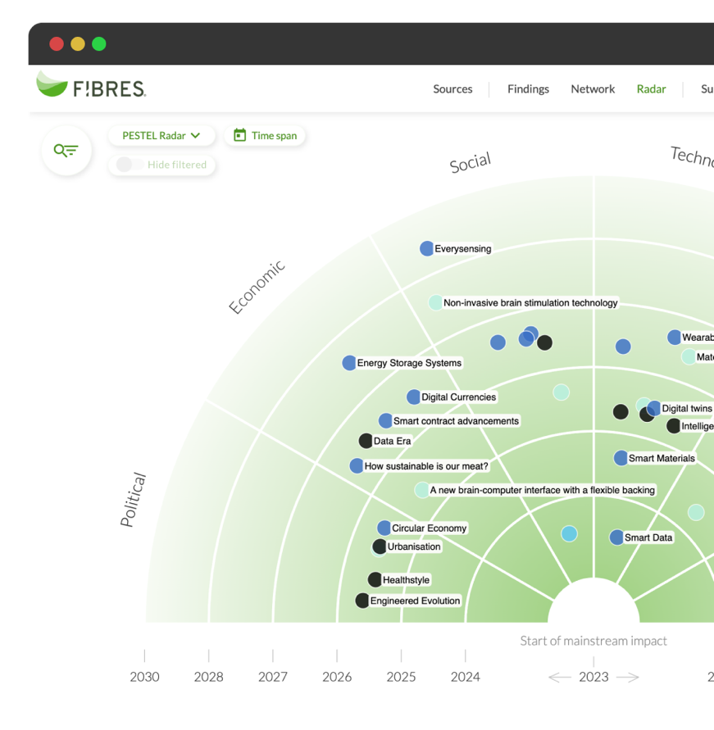
8 benefits of a live trend radar
Easily manage multiple radars online, in real time
Position trends easily (no copy-pasting!)
Work on your radar together with others
Write trend descriptions that open from your radar
Evaluate and discuss your trends in the same tool
Get ideas and suggestions on the topics of your radar
Take image exports of your radars
Share or embed a live radar on your website.

Slide 9
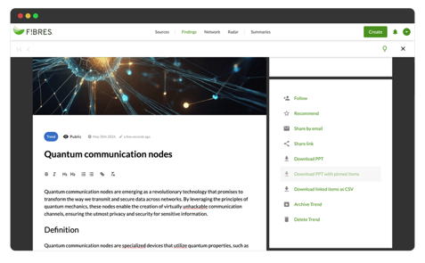

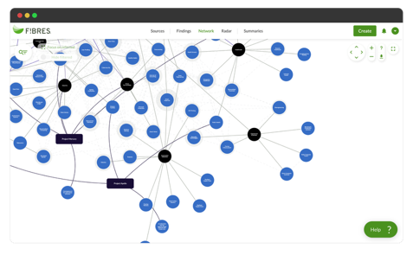



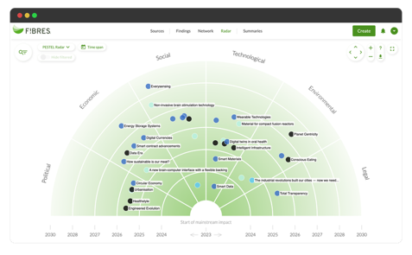


Build your own futures intelligence
Capabilities
Use cases
Collecting inputs
Strategy
Sense-making
Innovation
Summarizing & sharing
Other

Slide 10
FIBRES stood out with its strong capabilities, configuration flexibility, ease-of-use, excellent support, and affordability. We were able to quickly customize our own trend radar.
“
— Mike Bates, Enterprise Architect, ePlus

